Slide 1
“DAJK” App
DAJK: “Does AI Just Know”?
Scope: Create DAJK app to perform predictions for various scenarios by utilising machine learning algorithms, python libraries with front end UI and host on a cloud platform with public access
Team Members:
Daniela Cornea (DC)
Anh Huong (AH)
Kelvin Nguyen (KN)
Josh Lowe (JL)
Project repo: https://github.com/DCornea5/Final-Project.git

Slide 2
Technologies
Methods: Python, pandas, seaborn, matplotlib, plotly express, tqdm, sklearn, xgboost, lightgbm, nltk, pickle, Flask API, HTML/CSS/Bootstrap, github, Heroku, etc…
Datasets:
heart_disease.csv
Stress-Lysis.csv
bodyPerformance.csv
TravelInsurancePredictions.csv
psyc.csv
Absenteeism_at_work.csv
Zomato restaurant reviews
Sources:
Kaggle, https://www.kaggle.com/datasets/brsdincer/personality-scale-analysis
Dataworld, https://data.world/datasets/open-data

Slide 3
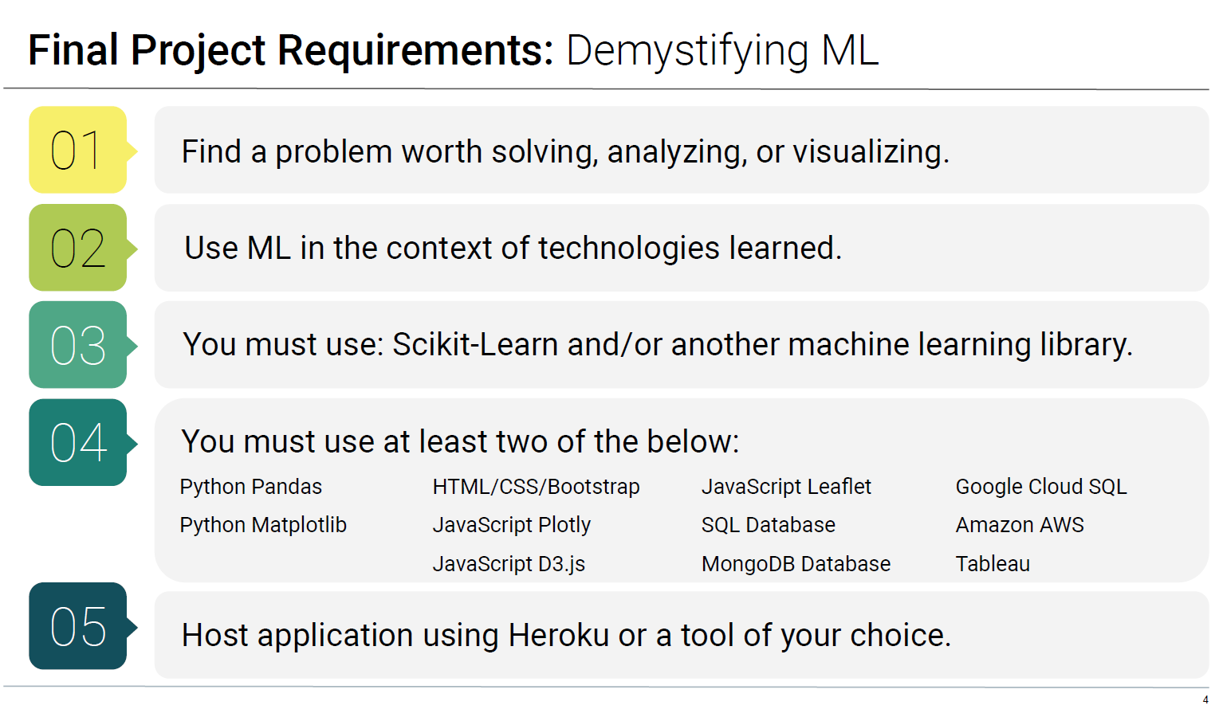
Project High Level Requirements

Slide 4
Project Plan
Research project topic and select datasets on various sources
Create project plan and github repo
Project is adopting Agile methodology for software development:
Iterations of design, coding, testing for the app’s front and back-end.
Minimum viable product (MVP): a working machine learning model (ML) with user interface (UI) front end that hosted on a cloud platform
Product: a completed a scalable front end web site with various ML models that hosted on a cloud platform.
On-going task allocations: self-manage, support other team members as required
Project presentation
Documentations:
Project docs, reports
Presentation pack

Slide 5
Project Schedules & Milestones
Date | Task # | Descriptions | Status
8/4 | 0 | Form the project team | Completed
10/4 18/4 | 1 | Select project topic Select datasets on various open sources ML models - perform exploratory data analysis(EDA), build, test, measure and save the models: Stroke prediction Body performance prediction Stress level prediction Travel Insurance prediction Personality classification | Completed
19/4 | 2 | High level design Present project proposal to instructors | Completed
20 – 29/4 | 3 | Front-end web site design | Started
30/4 | 4 | Functionality testing
1/5 | 5 | Finalise platform deployment End-to-end testing
2/5 | 6 | Completed presentation pack Presentation rehearsal
3/5 | 7 | Project presentation Project submission

Slide 6






Solution High Level Design (scalable)
Data
User Interface
EDA/ Visualisations
Option1
Option2
Option3
OptionN
Pre-processing
Algorithm
ML Models
Mod_1
Mod_N
Predictor

Slide 7
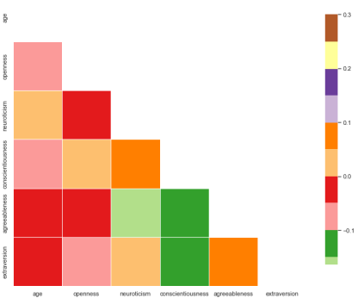
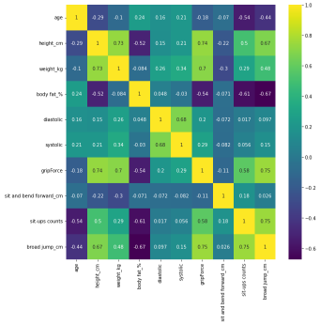
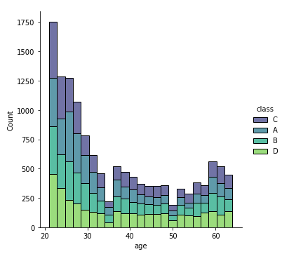
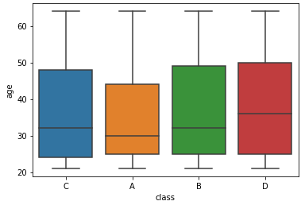
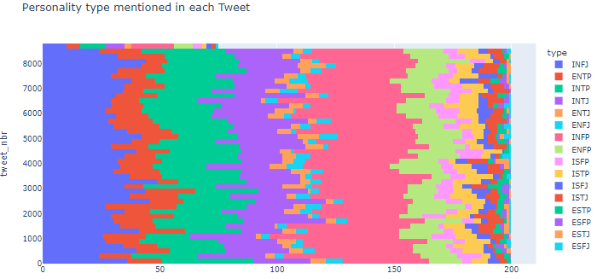
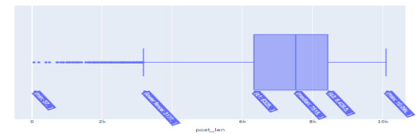
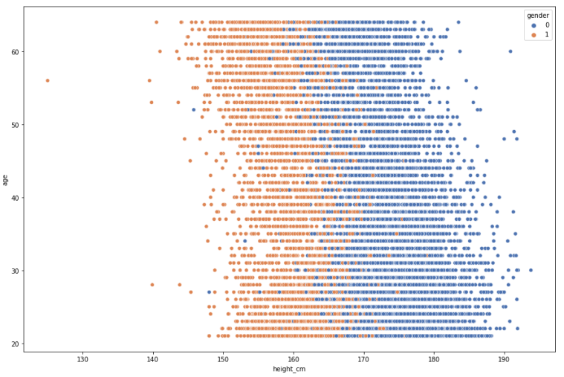
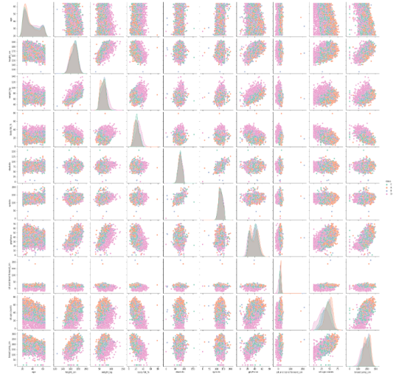
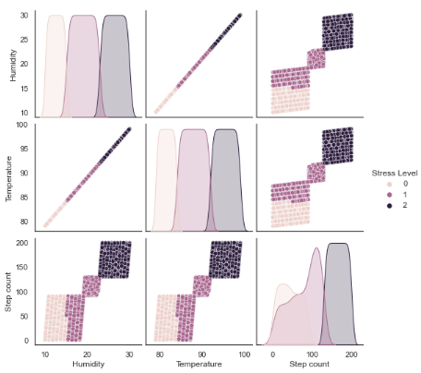
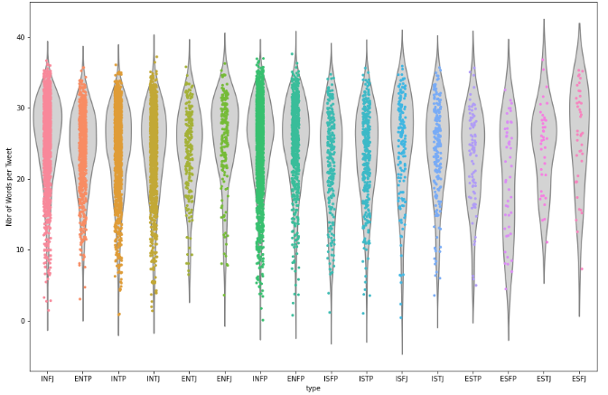
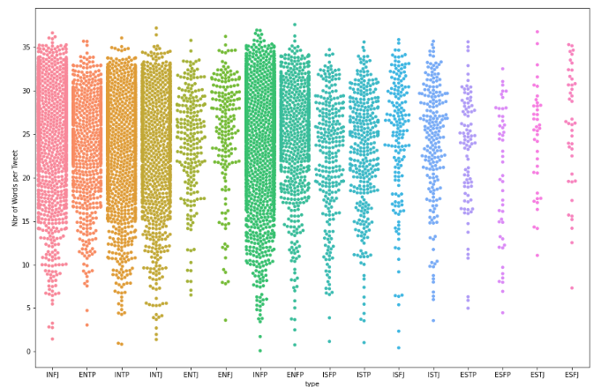
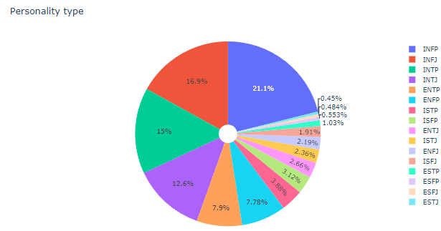
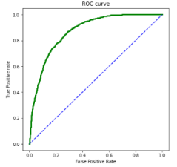
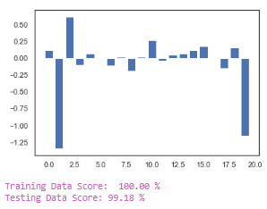
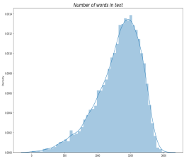
Data Visualisations

Slide 8
Machine Learning
“Does AI Just Know” models:
Stroke Prediction
Physical Stress Prediction
Body Performance Classification
Travel Insurance Indicator
Personality Classification
Completed Analysis ML models:
Absenteeism At Work
MTBI (Big5)
Zomato Restaurant Reviews

Slide 9
Cloud Deployment
Github – Heroku:
afdaf
dsafasfd
dsafadf
;lk;k;

Slide 10
Challenges
Performed Exploratory Data Analysis (EDA) on datasets
Zomato Restaurant Reviews.
Observations: Unable to utilise on the project as the data is heavily skewed for the restaurants in India
Absenteeism at work.
Observations: Applied 12 different ML methods, 17 out of 21 columns are seemed relevant. Not user friendly as too many fields are required user input
etc…adfafd
Etc…

Slide 11
Live App Demo

